Slide 1

Finding NES Properties using pLMs
3D Data Processing in Structural Biology Hackathon 2025
Dana Siton, Shay Guttmann, Noam Rosenmann,
Noa Birman and Tal Neumann
Tasks 3-4

Slide 2
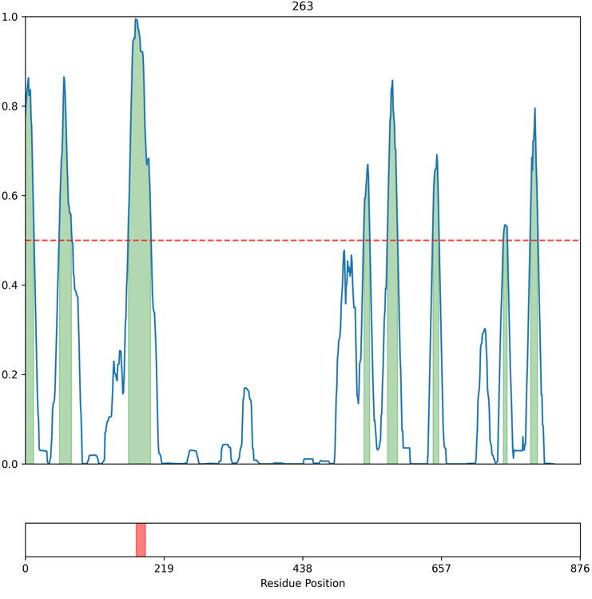
Human proteome screening for NES motifs
Large amounts of false positives are detected when screening proteins

Slide 3
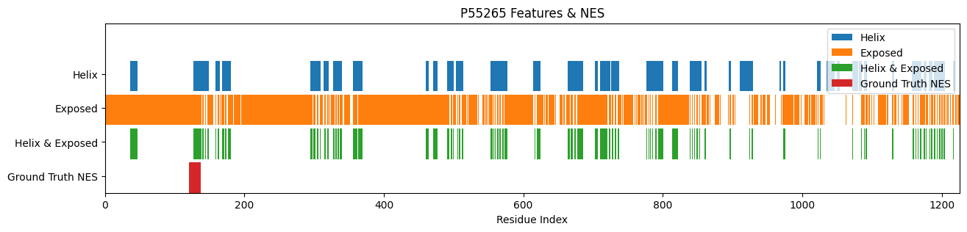
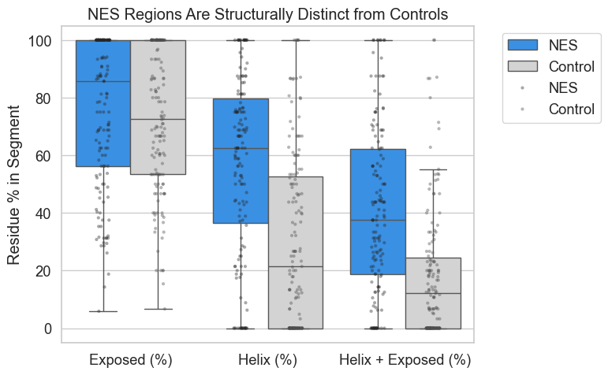
Structural Motifs of a NES
Verify some known structural characteristics of a NES peptide
We found that NES are significantly more in helical and exposed regions

Slide 4
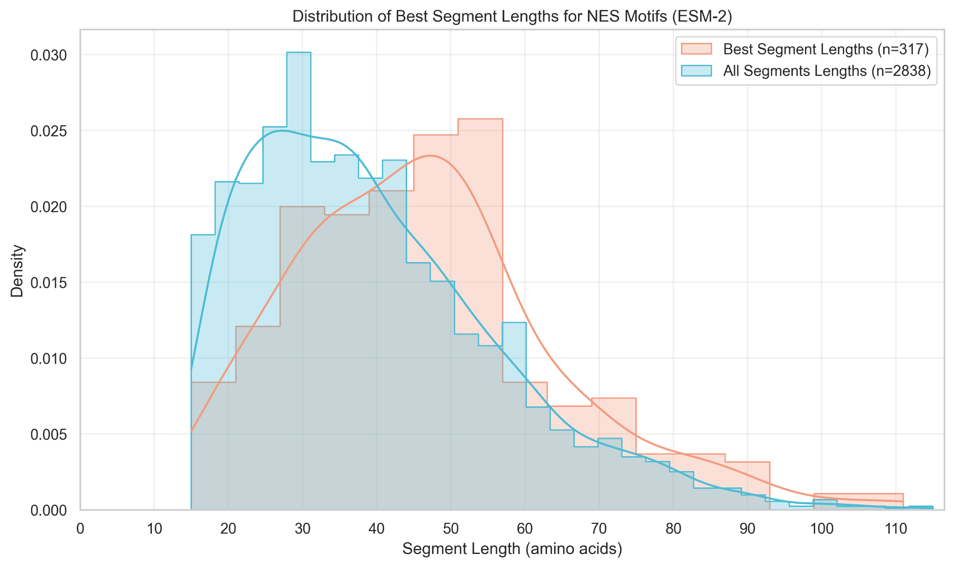
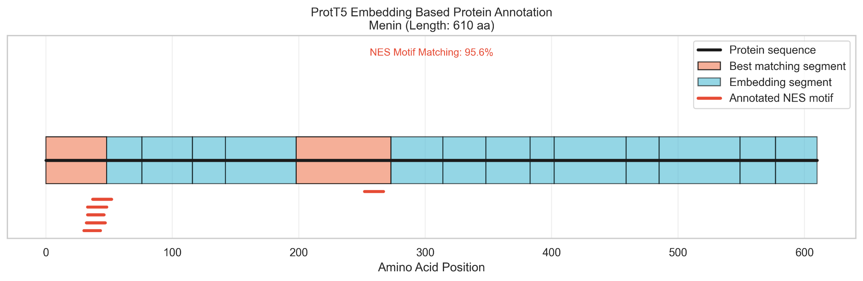
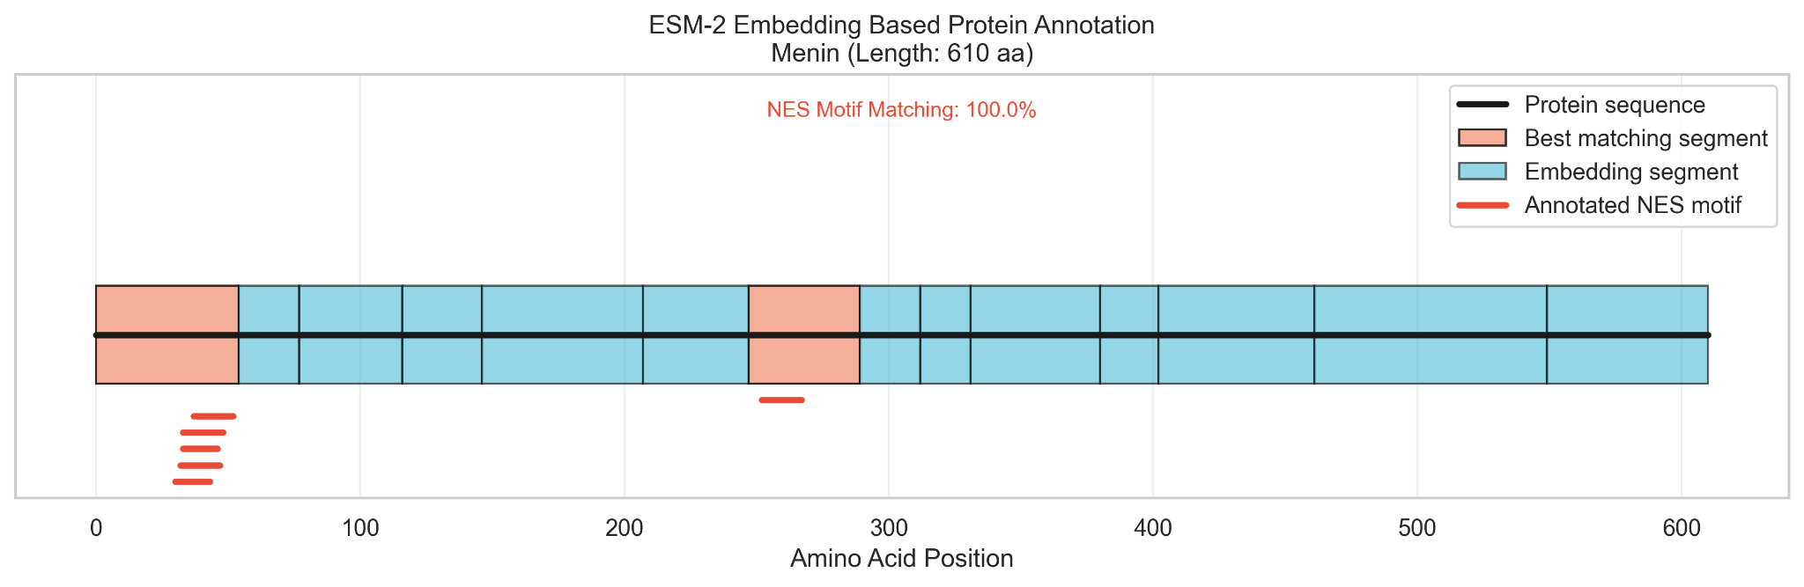
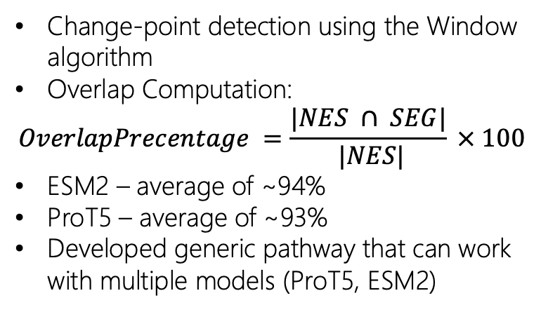
Precise NES detection using sequence segmentation
Change-point detection using the Window algorithm
Overlap Computation:
$$OverlapPrecentage =\frac{|NES ∩ SEG|}{ |NES|} × 100$$
ESM2 – average of ~94%
ProT5 – average of ~93%
Developed generic pathway that can work with multiple models (ProT5, ESM2)

Slide 5
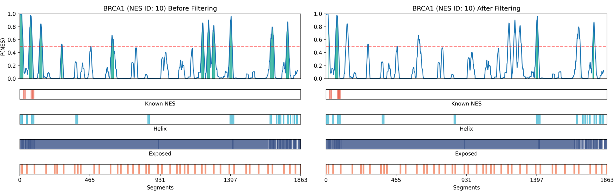
Cross referencing with NES characteristics reduces positive bias
We layered the information over the model prediction in order to reduce the false positive rate.
We managed to reduce the FP count two fold.
Metric | Before Filteration | After Filteration
TP | 2094 | 1116
FP | 12131 | 5843
Missed NES | 48 | 88

